Slide 1
PREPARING FOR GOING ABROAD -
READY TO GO COURSE, 1 CP

Slide 2
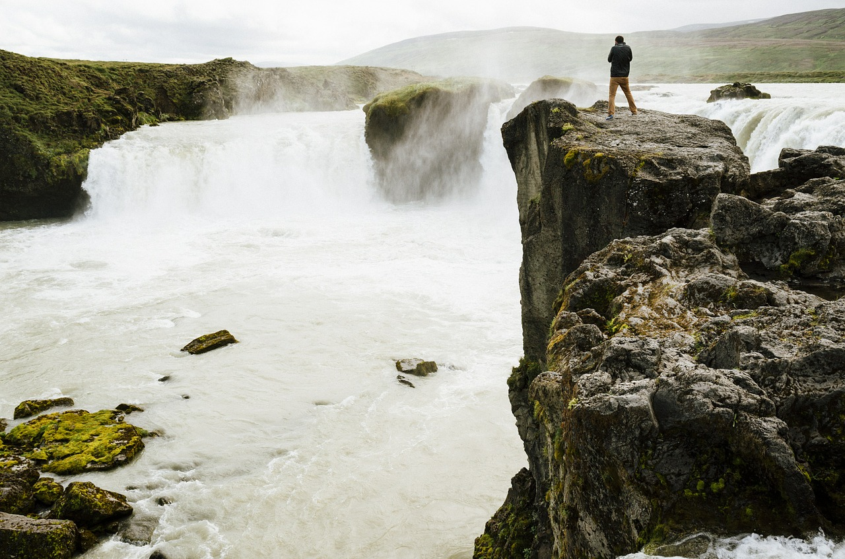
ALONE OR IN A GROUP

Slide 3
ALONE OR IN A GROUP
ALONE: EASY TO MEET NEW PEOPLE, DEVELOP LANGUAGE SKILLS. YOU BLEND IN WITH THE CROWD.
IN A GROUP OR WITH A FRIEND: SHARE EXPERIENCES, RELIEVE CULTURE SHOCK.
TO SOME DESTINATIONS YOU TRAVEL ALONE. THIS MAKES IT EASIER TO GET TO KNOW NEW PEOPLE, OBSERVE YOUR SURROUNDINGS AND USE YOUR LANGUAGE SKILLS.
IT IS EASIER TO BLEND INTO A NEW CULTURE AND MEET LOCAL PEOPLE WHEN YOU DON'T SPEAK A FOREIGN LANGUAGE WITH A MATE. IN SOME COUNTRIES, A WOMAN TRAVELLING ALONE CAN ATTRACT ATTENTION. IF YOU GET UNWANTED ATTENTION, YOU CAN ALWAYS SEEK OUT THE COMPANY OF ANOTHER TRAVELLER.

Slide 4
GOING ABROAD ALONE OR IN A GROUP
INTO MANY OF OUR DESTINATIONS YOU CAN TRAVEL TOGETHER WITH SOMEONE OR AS PART OF A GROUP. THIS ALLOWS YOU TO SHARE BOTH GOOD AND BAD EXPERIENCES WITH OTHERS. YOU WON'T EASILY FEEL ALONE, UNSAFE OR INSECURE. HOWEVER, WHEN TRAVELLING TOGETHER, COMPROMISES HAVE TO BE MADE AND PLANS AND SCHEDULES HAVE TO BE MADE TOGETHER.
WHETHER YOU ARE TRAVELLING ALONE OR TOGETHER WITH SOMEONE, YOU SHOULD START PLANNING AND PREPARING FOR YOUR TRIP WELL IN ADVANCE, AND YOUR INTERNATIONAL COORDINATOR WILL HELP YOU WITH ALL YOUR QUESTIONS AND PREPARE YOU FOR YOUR DEPARTURE (GENERAL COACHING, DESTINATION COACHING, PERSONAL COACHING).

Slide 6
Climate?

Slide 7
Northern India: from November to March the climate is relatively pleasant (daytime temperature 5-20 C), but sometimes the temperature can drop below zero.

Slide 8
NEPAL: FROM OCTOBER TO NOVEMBER IS THE MOST POPULAR SEASON FOR TOURISM. THE CLIMATE IS WARM AND THE WEATHER IS CLEAR. AVERAGE TEMPERATURES 15-20 C. NEPAL IS AN EARTHQUAKE ZONE, PLEASE CHECK THE GUIDELINES.
NORTHERN EUROPE JANUARY-MARCH: AVERAGE TEMPERATURES 0-(-5 C)
CENTRAL EUROPE JANUARY-MARCH: AVERAGE TEMPERATURES 5-10 C

Slide 9
DOCUMENTATION: THE ASSIGNMENTS - Create your own one drive folder: name it: International PortfolieYOURNAME. - Share it with your international coordinator, study counselor and the supervisor. 1. Assignment: Create a folder and share it.

Slide 10
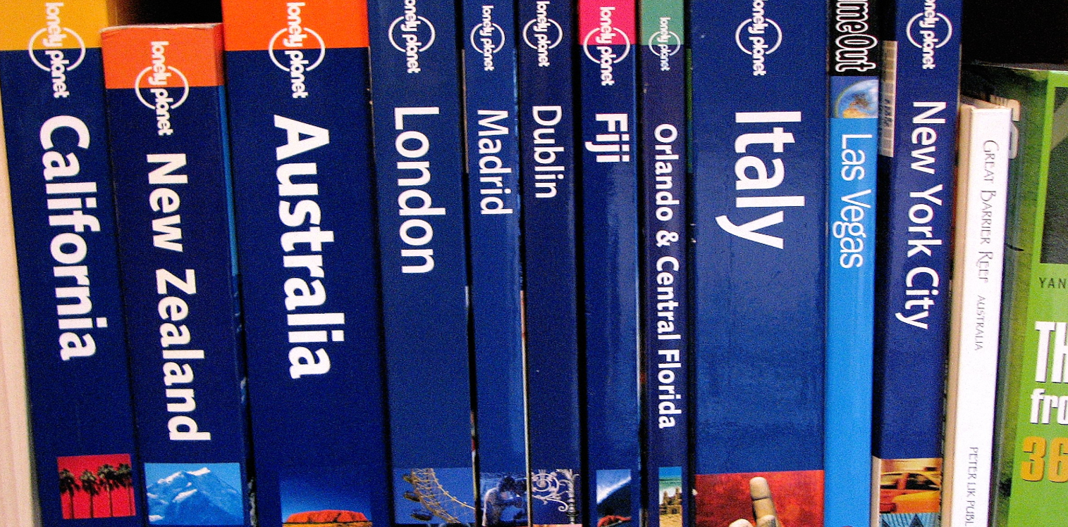
Collect information: previous exchangeS, friends, internet, library, books, films, travel guides.

Slide 11
Ask about the experiences of friends and other students as well as teachers who have been to the same destination. Read travel reports (ask your international coordinator). check the website of your future workplace/partner school. Borrow travel guides from the library (e.g. Lonely Planet).

Slide 12
Browse travel magazines. Surf the internet (sites such as Tripadvisor, Wikitravel, Lonely Planet, Pallontallaajat, Rantapallo). Download a travel app (e.g. XE Currency, Wi-Fi Finder, Skype, map apps e.g. Citymapper London, Google Translate/Deepl), Facebook, Twitter).

Slide 13
visit discussion forums. Read books and Watch films set in your destination country (e.g. Slumdog Millionaire, Drive to Nepal). Watch documentaries and travel programmes. Also be prepared to talk about Finland, your home town and your school. 2. ASSIGNMENT: Record your presentation of finland, your home town and school (Max 5 min.)

Slide 14
Exchange abroad as part of your qualification (degree)

Slide 15
Work-based learning abroad will give you competence points, not only for your vocational qualification(s), but also optional studies. Before you go, meet with your study counselor, your supervisor and your international coordinator and plan together how the period abroad will be part of your studies. Also agree on how you will complete the demonstration of skills (abroad or in Finland).

Slide 16
You will receive 1 competence point for participating in the general and destination coaching. In addition, you can choose from our range of other International Competence studies, such as language and culture courses to prepare you for your exchange. For information on how to complete your international studies, please contact your international coordinator and your study councellor.

Slide 17
The portfolio is graded as part of the Ready to go preparation (general and personal preparation), for which you receive a grade. Your international coordinator will grade the portfolio after the student returns. With your portfolio, you can show how well you have prepared for the exchange and what you have learnt. The portfolio is processed before, during and after the exchange. You will receive a TO DO list in the Ready to go preparation on the tasks to be saved in the folder.

Slide 18
When documenting your exchange, please remember not to write anything negative about our partner school or company, for example on a blog or elsewhere online be sure to not publish anything that is covered by trade secret or privacy laws. Please also ask for permission if you want to take pictures at the workplace (of the premises or people). You can communicate with people without a common language by using sign language. You can also make use of a symbol language map, and with that you can point to the picture to show what you mean.

Slide 19
Even if you feel like you don't speak perfect English - go anyway! You will get much more out of your trip if you know at least some of the language spoken in the destination country. - People appreciate that a foreigner knows at least a few words in the local language, such as greetings, thanks, apologies and numbers. Try to speak clear English that is understandable to non-native English speakers. Above all - have the courage to speak!!!!

Slide 20
Practise English or the language of the target country, e.g. short dialogues in the kitchen, restaurant, shop, on a trip or in the garage. You can see examples in the videos!! 3. Assignment: a) Facts about your destination Country (ATTACHMENT 3A). B) Find a video in English or in the language of the destination country on the topic you are working on. upload the link in the assignment 3a.

Slide 21
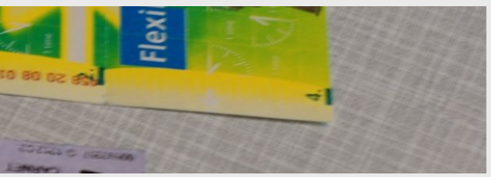
Travel tickets: your school's assistant FOR INTERNATIONAL AFFAIRS WILL BOOK YOur tickets (train, boat, flights etc.) Provide him/her your IBAN account number

Slide 22
TRAVEL INSURANCE

Slide 23
Through the school, you will be covered by travel insurance for the entire duration of your trip (travel, working time and time off). Keep your insurance certificate with you and show it to your doctor if necessary. In case of illness, first contact the emergency number of your insurance company, as they may have contracted doctors who can help you. You can also ask your local contact for advice on choosing a doctor. The insurance covers the cost of treatment for illnesses and accidents during the trip, as well as acute dental problems.

Slide 24
Baggage is not covered by the insurance; you must take out baggage insurance yourself if you want it. The insurance does NOT cover extreme activities (deep-sea diving, etc.) or illnesses you have already had before the trip. The school's liability insurance covers damage caused in the workplace.

Slide 25
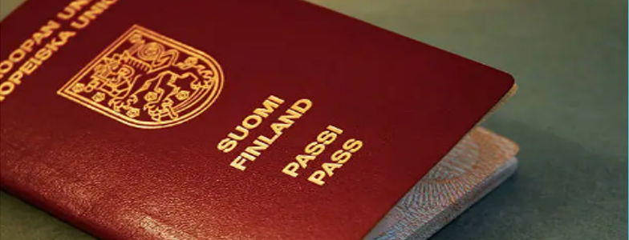
IMPORTANT DOCUMENTS

Slide 26
1) Passport (for some countries this must be valid for 6 months after your return) 2) visa: for non-European countries 3) ID card 4) credit card or debit card valid abroad 5) flight tickets and other travel tickets 6) learning/training agreement and certificate of attendance (signatures) 7) skills demonstration assessment documents if you will be carrying out the demonstration of skills abroad (this you get from your supervising teacher) 8) student card 9) a European Health Insurance Card (you can order one from Kela free of charge by using your bank credentials). Must be obtained before the trip

Slide 27
10) insurance certificate (from the Qu coordinator + Doctors statement) 11) luggage insurance certificate (take it yourself if you want one) 12) prescriptions (see health info) 13) vaccination card (see health info) 14) copy of hygiene passport, if available 15) contact details: home, to-coordinator, international coordinator, manager of international affairs, principal, local contact person, police and emergency number in the country of destination, address and phone number of the apartment, address and phone number of the workplace 16) Finnish embassy in the country. 4. Assignment: Contact information from the coordinator . Fill in and save in ONE DRIVE FOLDER.

Slide 28
LUGGAGE Don't take too much luggage with you! You will also be travelling on foot and lifting your luggage into the vehicles. You should only pack the essentials in your suitcase. 5. ASSIGNMENT: What to take with you: Link: https://flinga.fi/s/fdkw4w4

Slide 29
1. the previously mentioned travel documents and copies of these 2. cash and local currency IF NEEDED (e.g. JAPAN) e.g. Nepalese currency can only be obtained on the spot 3. daypack or shoulder bag with a crossbody strap 4. good shoes that allow you to walk a lot 5. FLASHLIGHT (torch in mobile phone) 6. Leatherman multi-tool etc. 7. batteries if you need them for your equipment 8. adapter, available in most bigger stores and at the airport 9. sewing supplies

Slide 30
10. large scarf or warm jacket etc. 11. own sheets (usually outside Europe, e.g. Nepal) 12. mobile phone, laptop, tablet, charger, possibly adapter (Japan) 13. earplugs 14. money belt 15. spare lenses, liquids, glasses 16. toiletries, small set for hand luggage 17. if your suitcase is delayed a set of CLOTHES IN your HAND LUGGAGE for the same reason

Slide 31
18. Medicines 19.passport photos 20. loose, warm clothing, especially for long flights 21. flight socks 22. souvenirs for work / host family 23. FAKE wallet 24. wet wipes or hand towel 25. suitcase lock, address/phone number tag for suitcase. Use online discussion forums or talk with people who have already been to the destination to find out what you might not be able to get in your destination.

Slide 32
IN PARTICULAR, PLACE ALL CHEMICAL PRODUCTS IN PLASTIC OR MINI-GRIP BAGS SO THAT THEY DO NOT GET MIXED UP WITH OTHER LUGGAGE IF THEY ARE OPENED DURING THE JOURNEY.
BE AWARE OF AIRLINE RESTRICTIONS ON THE NUMBER, SIZE AND WEIGHT OF LUGGAGE (USUALLY A MAXIMUM OF 20 KG IN A CHECKED BAG AND 8 KG IN A CARRY-ON BAG).
THE CHARGES ARE USUALLY RELATIVELY HIGH IF YOU HAVE TO PAY FOR EXTRA BAGGAGE OR EXCESS WEIGHT,. CHECK THAT YOUR HAND LUGGAGE DOES NOT CONTAIN ANY ITEMS OR SUBSTANCES PROHIBITED BY THE AIRLINE.
AS A RULE, LIQUID PRODUCTS IN CARRY-ON LUGGAGE MUST FIT INTO A 1 LITRE MINIGRIP BAG AND NO SINGLE LIQUID CONTAINER SHOULD BE LARGER THAN 1 DL. TOOTHPASTES AND OTHER GELS ARE ALSO CONSIDERED LIQUIDS.

Slide 33
Do not put anything of value in unlocked side pockets of your backpack or suitcase. Do not pack valuable jewellery or equipment in your suitcase. Mark all your luggage with an address label that does not come off (name, address AT THE destination on arrival and home ADDRESS on departure, telephone number and e-mail address). In your hand luggage you should include travel documents, warm clothing, drinks (bOUGHT after security check), snacks, reading or other entertainment, gum, earplugs, etc.

Slide 34
DEPARTURE

Slide 35
ARRIVE AT THE AIRPORT EARLY, AT LEAST 2 HOURS BEFORE THE DEPARTURE OF INTERNATIONAL FLIGHTS. THE SAME APPLIES TO BOTH ARRIVING AND DEPARTING FLIGHTS. THERE CAN BE LONG QUEUES AND CONGESTION AT CHECK-IN AND SECURITY.
CHECK IN ADVANCE THAT YOUR FLIGHT HAS NOT BEEN CANCELLED OR DELAYED. SOMETIMES A FLIGHT MAY BE OVERBOOKED, WHICH MEANS THAT LATE ARRIVALS MAY HAVE TO WAIT FOR THE NEXT FLIGHT. CHECK THE CHECK-IN PROCEDURES WITH YOUR AIRLINE AND, IN FINLAND, ON FINAVIA'S WEBSITE:
WELCOME TO FINAVIA AIRPORTS | FINAVIA

Slide 36
AT CHECK-IN, LEAVE YOUR LUGGAGE TO BE TRANSFERRED TO THE PLANE AND TAKE THE BOARDING PASS WHICH YOU WILL NEED TO BOARD THE PLANE. KEEP IT AND YOUR BAGGAGE TAG ATTACHED TO IT THROUGHOUT YOUR JOURNEY.
YOU CAN OFTEN CHECK IN ONLINE IN ADVANCE, AROUND 24 HOURS BEFORE DEPARTURE. YOU WILL STILL NEED TO PRINT OUT YOUR BOARDING PASS AND BAGGAGE TAG AT THE AIRPORT AND LEAVE YOUR BAGS AT THE DROP-IN COUNTER.

Slide 37
YOU CAN OFTEN CHOOSE YOUR SEAT ON THE PLANE YOURSELF AT CHECK-IN OR IN ADVANCE ONLINE ON THE AIRLINE'S WEBSITE (THERE MAY BE A CHARGE).
IF YOUR FLIGHT HAS STOPOVERS, CHECK AT CHECK-IN THAT YOUR BAGS WILL AUTOMATICALLY GO ALL THE WAY TO YOUR DESTINATION.
BE EXTRA CAREFUL WITH YOUR LUGGAGE, THERE ARE A LOT OF PICKPOCKETS AT AIRPORTS, AND YOUR BAG COULD GET LOST OR SOMEONE COULD PUT SOMETHING IN IT IF YOU ARE NOT CAREFUL.
AT MAJOR AIRPORTS, THE WALK (OR BUS RIDE AT HEATHROW, FOR EXAMPLE) TO THE DEPARTURE GATE CAN TAKE MORE THAN HALF AN HOUR. SO DON'T LEAVE YOUR TAX-FREE SHOPPING UNTIL THE LAST MINUTE, BUT FIND THE DEPARTURE GATE WELL IN ADVANCE.

Slide 38
DEPARTURE – AT THE AIRPORT

Slide 39
Depending on the country, you may be asked to fill in entry and customs forms on the plane. The FORMS are also available at the airport. At the airport, you will first have to go through border control and show your passport. You may also have to answer questions about the purpose and duration of your trip and your address in the country of destination. At border and security checks, behave in a friendly and calm manner. Check your bag to make sure you are taking the right one.
DESTINATION

Slide 40
if your luggage is lost or misplaced, contact your airline or the airport's general service desk. Sometimes your baggage can be delivered to your destination the next day or it can take several days. If your baggage is DAMAGED, please report it at the service desk. You are usually entitled to compensation for lost or damaged baggage. Preferably use public transport (train, bus), If not available, take a taxi, but make sure you get a legal taxi and agree the fare with the driver in advance. 6. Assignment: Find out in advance how to get from the airport to your accommodation and approximately how much THE cost WILL BE. In some of our destinations, you will be met at the airport by our local contact person, so make sure you have their phone number. Save THIS number in your phone.

Slide 41
ROOM SECURITY / IS EVERYTHING FUCNTIONING
CAN THE DOOR BE LOCKED PROPERLY
CAN A WINDOW BE LOCKED
ARE THERE LIGHTS, ELECTRICAL APPLIANCES
IS THERE HOT WATER AVAILABLE FROM THE TAPS
(SOME COUNTRIES HAVE RESTRICTIONS ON HOT WATER, SO SHOWERS MUST BE QUICK, E.G. ITALY).

Slide 42
WHEN YOU ARRIVE AT YOUR ACCOMMODATION (ROOM IN A DORMITORY OR SHARED APARTMENT, HOSTEL, HOTEL OR HOST FAMILY), CHECK THAT THE ROOM IS SAFE AND FUNCTIONAL: WHETHER THERE ARE MOSQUITOES (E.G. IN TANZANIA) OR OTHER INSECTS IN THE ROOM.
VALUABLES AND DOCUMENTS SHOULD BE KEPT IN A SAFE OR LOCKED SUITCASE AND THE ROOM DOOR SHOULD BE LOCKED.
CHECK THE HEATING SYSTEM (WITH THE HOST ORGANISATION TO AVOID ANY SURPRISES IN TERMS OF HEATING CONSUMPTION). YOU MAY HAVE TO REPLACE BROKEN ITEMS IN THE ROOM/APARTMENT, SO MAKE A NOTE OF BROKEN ITEMS IN ADVANCE.
CLEAN THE ROOM WELL WHEN YOU LEAVE, AND DON'T LEAVE ANY OF YOUR BELONGINGS THERE EVEN IF YOU NO LONGER NEED THEM.

Slide 43
TRAFFIC
FIND OUT IF YOU ARE ENTITLED TO STUDENT OR OTHER DISCOUNTS ON LOCAL TRANSPORT (E.G. BUS TICKETS).
FOLLOWING TRAFFIC RULES CAN BE DIFFERENT FROM FINLAND AND TRAFFIC CAN EVEN BE CHAOTIC IN SOME COUNTRIES (E.G. INDIA). BE CAREFUL IN TRAFFIC. BE AWARE OF LEFT-HAND TRAFFIC, E.G. IN MALTA.
OUR LOCAL CONTACT WILL ADVISE YOU ON WHERE TO BUY BUS TICKETS, HOW TO GET TO WORK, ETC. IT'S WORTH OF COURSE FINDING OUT ABOUT THESE THINGS YOURSELF BEFOREHAND ALSO.

Slide 44
BEFORE THE FIRST DAY OF WORK, CHECK THE ROUTE FROM YOUR HOME TO YOUR WORKPLACE / PARTNER SCHOOL IN ADVANCE. YOU CAN BRING AN ENGLISH-LANGUAGE BROCHURE OF YOUR SCHOOL WITH YOU TO THE WORKPLACE. YOU CAN ALSO BRING A SMALL SOUVENIR IF YOU WISH (E.G. CHOCOLATE FROM THE AIRPORT ETC.).
REMEMBER THE IMPORTANCE OF MAKING A GOOD FIRST IMPRESSION: LOOKING AND DRESSING NEATLY, BEING POLITE AND GREETING PEOPLE CHEERFULLY!
BE PREPARED TO TALK ABOUT YOURSELF, YOUR HOME TOWN, YOUR STUDIES AND FINLAND. CHECK WHETHER YOU SHOULD BRING YOUR OWN WORK CLOTHES/EQUIPMENT. WORKING HOURS DURING THE WORK PLACEMENT PERIOD ARE LOCATION-SPECIFIC AND YOU MAY NOT HAVE THE SAME WORKING HOURS AS IN FINLAND, SO CHECK BEFORE YOU START. ALSO, AS A RULE, HOLIDAY PERIODS DO NOT FOLLOW THE FINNISH PATTERN. THERE IS USUALLY ONLY ONE SHORT BREAK IN THE WORKING DAY, YOU CAN TAKE A PACKED LUNCH TO THE WORKPLACE IF NECESSARY.
7.A ASSIGNMENT: SMALL TALK TEST HERE
7 B. GROUP ACTIVITY: GET TOGETHER EVENT. GO AROUND IN CLASS AND GET TO KNOW EACH OTHER (HALF OF THE GROUP GOING ABROAD AND HALF JUST ARRIVED TO FINLAND AS EXCHANGE STUDENT). SMALL TALK
AT THE WORKPLACE

Slide 45
FOLLOW THE INSTRUCTIONS GIVEN TO YOU AT WORK AND ALWAYS ASK FOR HELP IF YOU NEED IT. REMEMBER THAT YOU ARE REPRESENTING YOUR SCHOOL AND YOUR COUNTRY ABROAD. DON'T BE LATE FOR WORK, BE PROACTIVE AND FLEXIBLE IN YOUR WORK. REMEMBER FRIENDLY CUSTOMER SERVICE AND A POSITIVE ATTITUDE. BE AWARE OF CULTURAL DIFFERENCES, E.G. HIERARCHY MAY BE STRICTER IN SOME COUNTRIES, SO RESPECTING YOUR SUPERIORS IS IMPORTANT.
REMEMBER GOOD MANNERS EVEN IN PROBLEM SITUATIONS. CONTACT YOUR INTERNATIONAL COORDINATOR WHO CAN OFTEN HELP YOU SORT THINGS OUT. BE SOCIAL AND CONSIDERATE TOWARDS COLLEAGUES. BY GETTING TO KNOW YOUR COLLEAGUES, YOU WILL LEARN MORE ABOUT THE CULTURE AND HAVE A BETTER TIME.
DON'T USE YOUR MOBILE PHONE OR THE INTERNET FOR PERSONAL MATTERS AT WORK OR DURING WORKING HOURS.
ASK WELL IN ADVANCE FOR A WORK CERTIFICATE FOR YOUR TRAINEESHIP. ALSO ASK THE WORKPLACE/HOST SCHOOL TO COMPLETE AND SIGN ANY AGREEMENTS YOU ARE TAKING WITH YOU AND EVENTUALLY SKILLS DEMONSTRATION DOCUMENT.

Slide 46
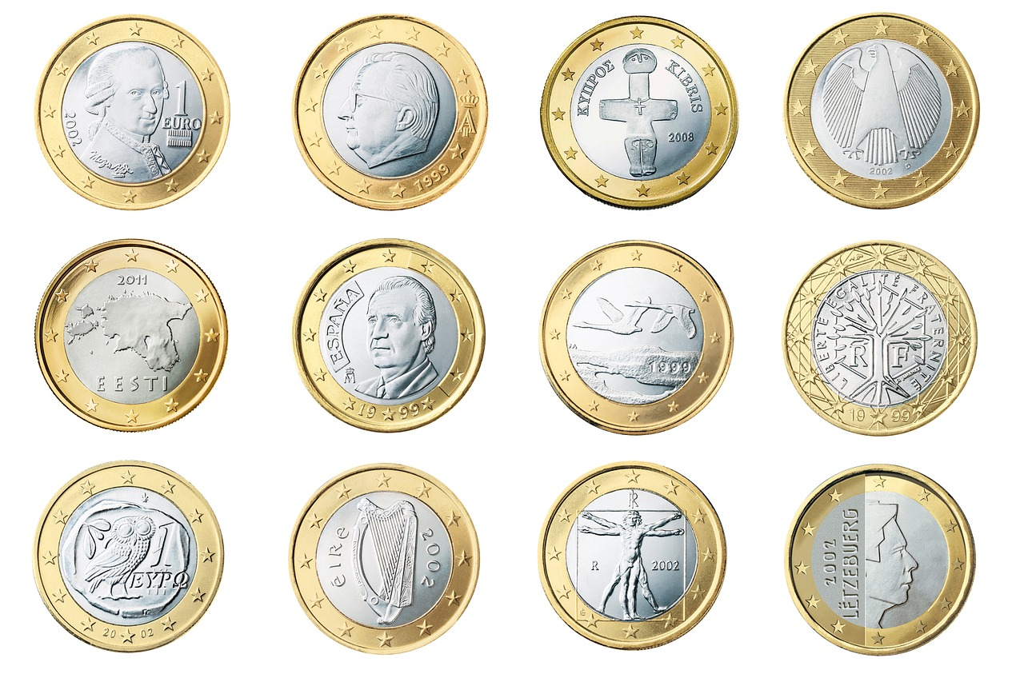
TRAVEL BUDgET
AS A RULE, YOUR GRANT WILL COVER TRAVEL TO THE DESTINATION, ACCOMMODATION AND LIVING EXPENSES. IN MOST CASES, YOU WILL ALSO RECEIVE A FOOD ALLOWANCE FOR WEEKDAYS FROM THE SENDING SCHOOL, WHICH WILL BE PAID INTO YOUR ACCOUNT AFTER YOUR RETURN WHEN YOU HAVE RETURNED ALL DOCUMENTS WITH SIGNATURES AND COMPLETED ALL ASSIGNMENTS IN AGREED ONEDRIVE FOLDER AND ANSWERED THE ERASMUS+ SURVEY QUESTIONNAIRE. CHECK THE AMOUNT OF THE GRANT WITH YOUR COORDINATOR.
FOR INFORMATION ON THE INCREASED STUDENT FINANCIAL SUPPORT AND STUDENT LOAN GUARANTEE FOR YOUR PERIOD ABROAD, PLEASE CONTACT THE FINNISH SOCIAL SECURITY INSTITUTION, KELA.
IT IS ALSO A GOOD IDEA TO SET ASIDE MONEY FOR HOBBIES, ACTIVITIES, EXCURSIONS OR TICKETS IF YOU WANT TO VISIT SIGHTS OR EVENTS ETC.
8. ASSIGNMENT: DO THE TRAVEL BUDGET

Slide 47
It is cheaper to prepare your own food if you can, rather than going to a restaurant or buying ready-made food. Tourist places, such as airports or tourist attractions, often have higher tourist prices and you can save money by buying lunch elsewhere. Find out the price level in the country in advance; in India and Nepal, the same amount of money will last longer than in countries such as Norway or Denmark.

Slide 48
HANDLING MONEY
CASH CAN SOMETIMES BE A MORE CONVENIENT METHOD OF PAYMENT. IT'S NOT ADVISABLE TO CARRY CASH WITH YOU FOR MORE THAN A FEW DAYS NEEDS, AND NEITHER SHOULD YOU CARRY YOUR ENTIRE TRAVEL FUND IN CASE OF THEFT. IT'S A GOOD IDEA TO KEEP SOME OF THE MONEY YOU CARRY IN DIFFERENT PLACES, SUCH AS A HIDDEN POCKET OR A PURSE (NOT ALL OF IT IN YOUR WALLET).
IT'S ALWAYS A GOOD IDEA TO HAVE SPARE CHANGE OR ENOUGH COINS IN YOUR POCKET SO THAT YOU CAN GET TO YOUR APARTMENT IN AN EMERGENCY OR PAY FOR SMALL PURCHASES WITHOUT OPENING YOUR WALLET.
DO NOT OPEN YOUR WALLET IN FRONT OF ANYONE AND REVEAL THE AMOUNT OF MONEY YOU HAVE.

Slide 49
HANDLING MONEY
SOME OF THE MONEY SHOULD BE PUT IN A FAKE WALLET, WHICH CAN BE GIVEN TO THE ROBBER IN THE EVENT OF A ROBBERY.
KEEP THE REST OF THE MONEY IN YOUR ROOM, FOR EXAMPLE IN A LOCKED SUITCASE.
YOU CAN ALSO USE AN INTERNATIONAL CREDIT OR DEBIT CARD (VISA, VISA ELECTRON, MASTERCARD) AS A MEANS OF PAYMENT, BUT BE PARTICULARLY CAREFUL WITH IT, AS IT CAN BE COPIED (E.G. AT AN ATM). TAKE A PARALLEL CARD WITH YOU.

Slide 50
HANDLING MONEY
THE SAFEST WAY TO USE YOUR CARD IS TO WITHDRAW CASH ONLY.
MAKE WITHDRAWALS PREFERABLY FROM AN ATM IN THE BANK OR INSIDE THE BANK IF THE CARD REMAINS IN THE MACHINE.
YOUR OWN BANK MAY CHARGE YOU FOR WITHDRAWALS FROM AN ATM, ACCORDING TO ITS TARIFF. IF YOUR CARD IS LOST OR STOLEN, REPORT IT IMMEDIATELY TO THE CARD BLOCKING SERVICE, WHOSE NUMBER YOU SHOULD HAVE ON YOUR PHONE, FOR EXAMPLE.

Slide 51
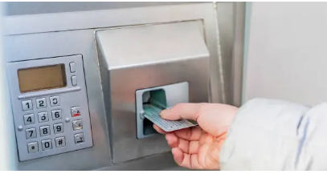
EXCHANGE OF CURRENCY
IN ALMOST EVERY DESTINATION, YOU CAN EXCHANGE EUROS FOR LOCAL CURRENCY AT A BANK OR CURRENCY EXCHANGE OFFICE (E.G. FOREX).IF POSSIBLE, EXCHANGE LOCAL CURRENCY WHEN IN IN FINLAND.
YOU CAN ALSO WITHDRAW MONEY, FOR EXAMPLE AT THE AIRPORT IN THE DESTINATION, TO GET LOCAL CURRENCY (E.G. FOR JAPAN).
IT IS A GOOD IDEA TO HAVE CASH ON HAND FROM THE START OF YOUR TRIP (E.G. FOR TAXIS OR BUSES AT THE AIRPORT).

Slide 52
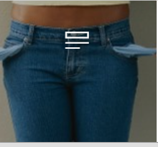
What to do if you run out of money
DURING YOUR TRIP, KEEP AN EYE ON HOW MUCH MONEY YOU HAVE LEFT AND TRY TO STICK TO YOUR BUDGET. KEEP TRACK OF YOUR CREDIT OR DEBIT CARD BALANCE.
DON'T CARRY ALL YOUR TRAVEL MONEY WITH YOU, AS THERE IS ALWAYS A CHANCE OF BEING ROBBED. IT IS CONVENIENT TO TRANSFER MONEY TO YOUR ACCOUNT VIA AN ONLINE BANK.
IF YOUR WALLET IS STOLEN AND YOUR CARD IS THERE, YOU CAN ALSO TRANSFER MONEY FROM FINLAND VIA MONEY TRANSFER SERVICES (E.G. MONEYGRAM AND WESTERN UNION) TO A LOCAL CASH WITHDRAWAL POINT (E.G. A BANK).

Slide 53
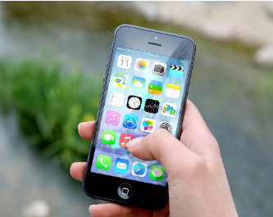
MOBILE PHONE
BEFORE YOU GO, CHECK WITH YOUR OPERATOR THAT YOUR PHONE WORKS ABROAD AND IN THE COUNTRY YOU'RE GOING TO (SUBSCRIPTION-SPECIFIC BLOCKING).
WHEN ABROAD, YOU CAN CHOOSE BETWEEN SEVERAL OPERATORS, CHECK THE PRICES OF CALLS AND SMS MESSAGES WITH YOUR OPERATOR. REMEMBER THAT ABROAD YOU ALSO PAY TO RECEIVE A CALL TO YOUR FINNISH NUMBER. IF YOUR PHONE IS STOLEN, SWITCH IT OFF IMMEDIATELY (CALL YOUR OPERATOR'S EMERGENCY NUMBER).
YOU CAN ALSO LOCK YOUR PHONE'S SCREEN (REPORT IT ANYWAY). PREPAID MAY BE CHEAPER. BUT CHECK THAT YOUR PHONE IS NOT BLOCKED FROM USING ANOTHER OPERATOR'S CARD.

Slide 54
INTERNET
SURFING THE WEB ON YOUR PHONE OR OTHER DEVICE CAN BE VERY EXPENSIVE ABROAD. CHECK WITH YOUR OPERATOR IN ADVANCE ABOUT ROAMING CHARGES.
CHECK THAT THE INTERNET IS NOT TURNED ON AUTOMATICALLY: BLOCKING DATA ROAMING IS USUALLY THE DEFAULT SETTING ON YOUR SMARTPHONE AND IF NOT, YOU CAN TURN OFF MOBILE DATA MANUALLY. THIS PREVENTS YOUR PHONE FROM ACCESSING THE INTERNET OR USING OTHER APPLICATIONS THAT REQUIRE DATA TRANSFER WHILE ABROAD, SUCH AS MAP SERVICES OR INSTANT MESSAGING APPS LIKE IMESSAGE AND WHATSAPP.
SENDING OR RECEIVING PICTURE OR VIDEO MESSAGES IS ALSO NOT POSSIBLE. TRY TO FIND A FREE WIRELESS NETWORK, WIFI (LOOK FOR SIGNS E.G. IN SCHOOLS, HOTELS, RESTAURANTS, PUBLIC TRANSPORT). DATA ROAMING CAN BE TURNED ON TEMPORARILY. DO NOT LOG ON TO UNKNOWN NETWORKS.

Slide 55
Security and RISKS
RISKS ABROAD:
ROBBERY
PICKPOCKETING
ASSAULT
RAPE
DRUGGING
KIDNAPPING

Slide 56
Security and RISKS
NATURAL DISASTER
TERRORIST ATTACK
BOMB ATTACK
DEMONSTRATIONS AND LARGE CROWDS
DANGEROUS TRAFFIC
DISEASES
POOR HYGIENE
POISONOUS PLANTS AND ANIMALS
THE MAJORITY OF TRAVELLERS NEVER FALL VICTIM TO ANY OF THE ABOVE. HOWEVER, YOU SHOULD ANTICIPATE SITUATIONS AND REDUCE THE RISK EVEN FURTHER.

Slide 57
Predicting risks
KEEP YOUR EYES OPEN AND BE ALERT. DON'T LOOK AT YOUR MOBILE PHONE, FOR EXAMPLE, WHEN YOUR ATTENTION IS ELSEWHERE.
ROBBERY/ PICKPOCKETING: KEEP YOUR RUCKSACK LOCKED AND YOUR HANDBAG WITH THE STRAP ACROSS YOUR BODY. KEEP VALUABLES AND MONEY DEEP IN YOUR BAG. HOLD ON TO YOUR BAG, ESPECIALLY IN LARGE CROWDS SUCH AS WHEN LEAVING A TRAIN, WHERE IT IS EASY FOR A PICKPOCKET TO OPERATE.
DON'T KEEP YOUR WALLET IN YOUR BACK POCKET.
KEEP GOLD JEWELLERY, VALUABLE-LOOKING WATCHES, CAMERAS AND MOBILE PHONES OUT OF SIGHT. DON'T GET INTO A "DARK" TAXI THAT COULD ROB YOU. DON'T GET DRUNK, AS THIS MAKES YOU AN EASY TARGET.

Slide 58
Predicting risks
LEAVE YOUR PASSPORT AND PREFERABLY YOUR CREDIT CARD AT THE ACCOMMODATION. YOU CAN GIVE THE ROBBER A FAKE PURSE.
DRUGS: NEVER ACCEPT ANYTHING TO DRINK OR EAT FROM A STRANGER, E.G. SOFT DRINKS OR SWEETS, AS THESE CAN BE USED TO DRUG TOURISTS WITH KNOCKOUT DROPS. DO NOT LEAVE FOOD OR DRINK CONTAINERS UNATTENDED IN A RESTAURANT.
THREATENING SITUATIONS: IF YOU ARE THREATENED WITH VIOLENCE, RUN AWAY; IF YOU CANNOT, TRY TO GET OUT OF THE SITUATION BY TALKING OR DEFENDING YOURSELF AND SHOUTING FOR HELP AT ALL TIMES.

Slide 59
Predicting risks
TRAFFIC - AS A PEDESTRIAN, KEEP TO THE SIDE OF THE ROAD, LOOK IN ALL DIRECTIONS AT THE CROSSING AND BE CAREFUL WHEN CROSSING THE STREET.
AVOID LARGE GATHERINGS SUCH AS DEMONSTRATIONS.
FOLLOW FOREIGN NEWS BEFORE YOU LEAVE AND LOCAL AND INTERNATIONAL MEDIA IN THE DESTINATION.
BEFORE AND ON THE GROUND, FOLLOW THE STATE DEPARTMENT'S TRAVEL ADVISORIES ON REGIONAL RISKS TO THE DESTINATION COUNTRY, SUCH AS NATURAL DISASTERS OR TERRORIST THREATS. MAKE A PRE-DEPARTURE TRAVEL DECLARATION ON THE WEBSITE OF THE MINISTRY OF FOREIGN AFFAIRS, SO THAT THE EMBASSY IN FINLAND KNOWS WHERE YOU ARE IN CASE OF DISASTERS AND CAN WARN YOU ABOUT THEM. FOLLOW THE LOCAL MEDIA AND THE INSTRUCTIONS GIVEN BY THE AUTHORITIES IN CASE OF A CRISIS.
9. ASSIGNMENT: DO THE ANNOUNCEMENT OF TRAVELLING HERE: ANNOUNCEMENT OF TRAVELLING

Slide 60
Reporting a crime and ABOUT the authorities
MEMORISE THE NUMBER FOR THE POLICE AND LEARN HOW TO CALL FOR HELP IN THE LOCAL LANGUAGE.
IN THE EVENT OF THEFT, ROBBERY OR ASSAULT, YOU MUST REPORT THE CRIME TO THE LOCAL POLICE SO THAT YOU CAN CLAIM COMPENSATION, FOR EXAMPLE, FOR STOLEN GOODS UNDER YOUR LUGGAGE INSURANCE (NOTE: YOU MUST TAKE OUT LUGGAGE INSURANCE YOURSELF).
ASK FOR A COPY OF THE CRIMINAL COMPLAINT TO ACCOMPANY YOUR CLAIM.
IT IS ALSO POSSIBLE FOR SOMEONE TO PRETEND TO BE A PUBLIC OFFICIAL, FOR EXAMPLE BY ASKING FOR MONEY OR ID IN THE MIDDLE OF THE STREET. IN THIS CASE, SHOW A COPY OF YOUR PASSPORT.

Slide 61
IF YOU LOOSE YOUR PASSPORT
IF YOUR PASSPORT IS LOST, REPORT IT TO THE LOCAL POLICE.
GO TO THE FINNISH EMBASSY WITH A COPY OF THE CRIMINAL COMPLAINT. IF THERE IS NO SUCH REPRESENTATION IN YOUR DESTINATION COUNTRY, YOU CAN ALSO CONTACT ONE FROM ANOTHER NORDIC OR EU COUNTRY.
THE EMBASSY OR CONSULATE WILL ISSUE YOU WITH A TEMPORARY PASSPORT. IT HELPS IF YOU HAVE A COPY OF YOUR LOST PASSPORT AND A PHOTO IN YOUR EMAIL AND ON THE CLOUD (VERY IMPORTANT).
10. ASSIGNMENT: TAKE A PHOTO OF YOUR IMPORTANT DOCUMENTS TO ONEDRIVE FOLDER AND SAVE THE TELEPHONE NUMBERS IN YOUR PHONE ALSO.

Slide 62
PREDICTION
DO NOT MOVE, ESPECIALLY ALONE, IN UNLIGHTED AREAS OR WHERE THERE ARE NOT MANY PEOPLE AROUND.
TAKE A TAXI AFTER DARK AND PLAN YOUR ROUTE IN ADVANCE.
DON'T LOOK AS IF YOU ARE LOST, EVEN IF YOU ACTUALLY ARE. DON'T LOOK AT A MAP OR GUIDEBOOKS IN THE MIDDLE OF THE STREET, BUT GO TO A SAFE-LOOKING CAFÉ, SHOP OR OTHER INDOOR SPACE TO STUDY THEM.
DRESS IN PLAIN AND CHEAP CLOTHES AND DO NOT ATTRACT ATTENTION WITH VALUABLES OR BEHAVIOUR.

Slide 63
TRAVEL BULLETIN - PREDICTION
BEFORE YOU LEAVE, CHECK THE FINNISH MINISTRY OF FOREIGN AFFAIRS' TRAVEL BULLETINS, WHICH INDICATE THE COUNTRIES AND AREAS WHERE YOU ARE LIKELY TO BE IN DANGER, FOR EXAMPLE BECAUSE OF A POLITICAL CRISIS, GUERRILLA ACTIVITY OR NATURAL DISASTER.
GET INFORMATION FROM THE INTERNET AND TRAVEL GUIDES, AND FROM TEACHERS, STUDENTS AND PEOPLE YOU KNOW WHO HAVE BEEN THERE BEFORE ABOUT THEIR RECOMMENDATIONS AND EXPERIENCES.
ONCE IN THE DESTINATION, TALK TO YOUR LOCAL CONTACT OR OTHER LOCALS, E.G. COLLEAGUES, ABOUT SAFETY IN DIFFERENT AREAS, FOR EXAMPLE IN A PARTICULAR DISTRICT.

Slide 64
Codes from different cultures: hand signs, etc.

Slide 65
The four phases of culture shock
GETTING TO KNOW PEOPLE: TALKING TO LOCAL PEOPLE IMMEDIATELY REDUCES THE SHOCK, BUT GETTING TO KNOW PEOPLE PROPERLY CAN BE DIFFICULT. HOWEVER, THE MOST IMPORTANT THING IS TO MAKE AN EFFORT TO GET TO KNOW NEW PEOPLE - EVEN IF THEY ARE OTHER TRAVELLERS OR TRAINEES.
TALK OPENLY TO YOUR FELLOW TRAVELLERS TOO.
TRY TO BE POSITIVE AND NOT NEGATIVE ABOUT EVERYTHING, INCLUDING FOOD, CUSTOMS, DRESS, LANGUAGE, PLACE AND PEOPLE.
IT IS GOOD TO THINK ABOUT THE CAUSES OF THE CULTURE SHOCK AND REMEMBER THAT THE REASON FOR GOING TO ANOTHER CULTURE OR FOREIGN COUNTRY IS TO EXPERIENCE SOMETHING DIFFERENT.
GIVE YOURSELF TIME: YOU CAN TAKE YOUR TIME AND GET USED TO THE NEW PLACE LITTLE BY LITTLE. DON'T EXPECT THE SHOCK TO GO AWAY IMMEDIATELY.
HTTPS://WWW.YOUTUBE.COM/WATCH?V=ZGHLKXW10Z0
11. ASSIGNMENT: SEARCH ONLINE FOR EXAMPLES OF CULTURAL SHOCKS EXPERIENCED BY FOREIGNERS IN FINLAND AND BY EXCHANGE STUDENTS IN YOUR DESTINATION COUNTRY (4 EXAMPLES IN TOTAL). SAVE THE LINKS IN YOUR ONEDRIVE FOLDER.

Slide 66
CULTURE SHOCK
CULTURE SHOCK REFERS TO THE STRESS OF ADAPTING TO A FOREIGN COUNTRY AND CULTURE.
VARIOUS DEGREES OF CULTURAL ADAPTATION OCCUR WHENEVER A PERSON CHANGES FROM A FAMILIAR ENVIRONMENT TO A NEW ONE.
SEE VIDEO:
https://youtu.be/gb_Sf9m2BDo

Slide 67
The four phases of culture shock
THE HONEYMOON PERIOD IS A TOURISTY TIME, WITH A CURIOUS AND UNCOMPLICATED APPROACH TO THINGS. FOREIGN CULTURES ARE EXCITING, FASCINATING AND WONDERFUL. HONEYMOON
THE SHOCK PHASE DEVELOPS GRADUALLY. AFTER A WHILE, LITTLE THINGS START TO ANNOY YOU, AND YOU START TO ASK YOURSELF A LOT OF QUESTIONS: WHY ON EARTH DO I HAVE TO DO THIS THING IN SUCH A SILLY WAY? YOU MAY ALSO FEEL MORE TIRED THAN USUAL AND LESS EAGER TO TRY NEW THINGS.

Slide 68
The four phases of culture shock
3. IN THE REACTION PHASE, THE LOCAL CULTURE IS NO LONGER APPEALING. THOUGHTS MAY BE FILLED WITH WORRY, SADNESS OR MELANCHOLY. RETURNING HOME SEEMS TEMPTING. AT THIS STAGE, PERSONAL ACTIVITY IS CRUCIAL. YOU NEED TO REDISCOVER YOUR ORIGINAL ENTHUSIASM.
4. IN THE SETTLING-IN PHASE, THE NEW LIFE SITUATION IS ACCEPTED AND THE POSITIVE ASPECTS OF THE NEW CULTURE BEGIN TO BE SEEN. YOU BEGIN TO UNDERSTAND WHY PEOPLE BEHAVE THE WAY THEY DO. YOU START TO FIT IN AND FEEL AT HOME.

Slide 69
The four phases of culture shock
RETURN SHOCK
RETURN SHOCK USUALLY COMES UNEXPECTEDLY:
EVEN IF YOU ARE HAPPY TO BE BACK HOME, YOU MAY FEEL EMPTY, NOT THE SAME PERSON WHO WENT ABROAD, BUT WHO HAS LEARNED NEW WAYS OF BEHAVING, ACTING AND UNDERSTANDING WHILE LIVING ABROAD. SUDDENLY YOU ARE NO LONGER ON THE SAME WAVELENGTH AS YOUR FELLOW HUMAN BEINGS.
KEEPING IN TOUCH WITH YOUR HOME COUNTRY DURING THE TRIP IS A GOOD WAY TO EASE THE SHOCK OF RETURNING HOME.

Slide 70
After the exchange
Answer the Erasmus+ survey concerning your exchange. If you do not get the link so please check your junk email.
Decide with your supervisor when you will tell your classmates about the exchange: DATE:_______/________/ _______ Remind your teacher about this!!!
Feedback discussion with your international coordinator: Returning the above documents signed+ report and other assignments. After the meeting the competence points will be put to studenta.

